Slide 1
Maternal & Infant Health:
A Closer Look by Race/Ethnicity
Baltimore City 2013-2017
Bureau of Maternal and Child Health
Division of Youth Wellness & Community Health
Baltimore City Health Department

Slide 2

Objectives of the Profile
To reveal racial inequities in birth outcomes in Baltimore City
A background to racial inequity at the systemic & structural level is provided to give context to the existence of racial inequities
2. All indicators are disaggregated by race/ethnicity to examine racial inequities in birth outcomes
3. Graphs are developed to help visualize the trend & magnitude of racial inequity

Slide 3
Racial Inequities: Behind the Data
It’s Not Race…
Race is not a natural characteristic that dictates individual behavior or health status
It’s Not Poverty…
Poverty matters when it comes to health but doesn’t fully explain why we see differences by race
It’s Racism.
Exposure to racism is the difference:
  Experiences of discrimination (interpersonal
  & institutional)
  Racial residential segregation (i.e. lack of resources, disinvestment)
  Bodily response to chronic/heightened stress
  over the life course (i.e. allostatic load, “weathering”)

Slide 4
It’s Not Race…
Race does not dictate our biologic responses or health outcomes
  The concept of race was determined by people (i.e. socially constructed) and has no basis in biology or genetics
  The Human Genome Project found that people of different races were more similar genetically than people of the same race with ancestors from different countries of origin
Source: https://www.genome.gov/human-genome-project
Notes:
Look for a map for different ethnicities?
It’s Not Race:
It is imperative that we do not see “race”, a social construct, as the risk factor for racial disparities.
“Race” is actually a measure of exposure to systemic racism, and ultimately, its effects on the body
https://sitn.hms.harvard.edu/flash/2017/science-genetics-reshaping-race-debate-21st-century/
Bibliography:
Race and Genetics:
DeSisto, C.L. et al (2018). Deconstructing a Disparity: Explaining Excess Preterm Birth among U.S. born Black Women. Annals of Epidemiology, 28 (4), 225-230.
Gannon, M. (2016). Race is a Social Construct? Scientists Argue: Racial Categories are Weak Proxies for Genetic Diversity and Need to be Phased Out. Scientific American. Live Science
Tukufu, Z et al. (2015). Race, Methodology, and Social Construction in the Genomic Era. The ANNALS of the American Academy of Political and Social Science, 661(1), 109-127
Systems:
Bailey, Z. et al (2017). Structural Racism and Health Inequities in the USA: Evidence and Interventions. The Lancet, 389 (10077), 1453-1463.
Feagin, J. & Bennefield, Z. (2014). Systemic Racism and U.S. Health Care. Social Science and Medicine, 103, 7-14.
Greer, T.M., Brondolo, E., & Brown, P. (2014). Systemic Racism Moderates Effects of Provider Racial Biases on Adherence to Hypertension Treatment for African Americans. Health Psychology, 33(1), 35-42.

Slide 5
It’s Not Poverty…
The disproportionate experience of poverty among Black, Indigenous, and People of Color is by design (i.e. deliberate exclusion from social safety nets & deliberate isolation from resources)
Poverty can impact one’s ability to protect their health, but racial disparities persist even among those with high income levels

Slide 6
It’s Racism.
Racism leads to Stress that negatively impacts Health
  Systemic/Structural racism is associated with chronic stress and leads to elevated rates of disease among Black, Indigenous and People of Color including: heart disease, high blood pressure, and obesity.
Racism impacts access to opportunities & resources which can negatively impact Health
Experiences of Racism & bias in the healthcare system lead to poor quality of care, delays in treatment, and poor Health outcomes

Slide 7
How Racism Impacts Health in Baltimore City: Hyper Racial Segregation
Intentionally racist policies by the US federal government (i.e. redlining, GI Bill)
Along with continued state and local disinvestment in communities of color (i.e. public education, transportation, healthful food access)
Predominately Black neighborhoods in Baltimore are structurally oppressed leading to a lack of resources & limited opportunities to promote health
This hyper-segregated area takes on the geographic pattern of a butterfly in the city, mirroring the same areas that were historically redlined (an area known today as the “Black Butterfly”)
Notes:
Baltimore’s hyper-segregated neighborhoods (an area known as the “Black Butterfly”):

Slide 8
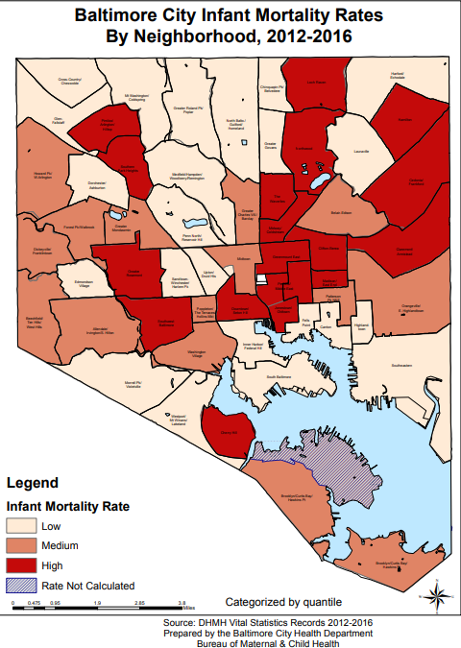
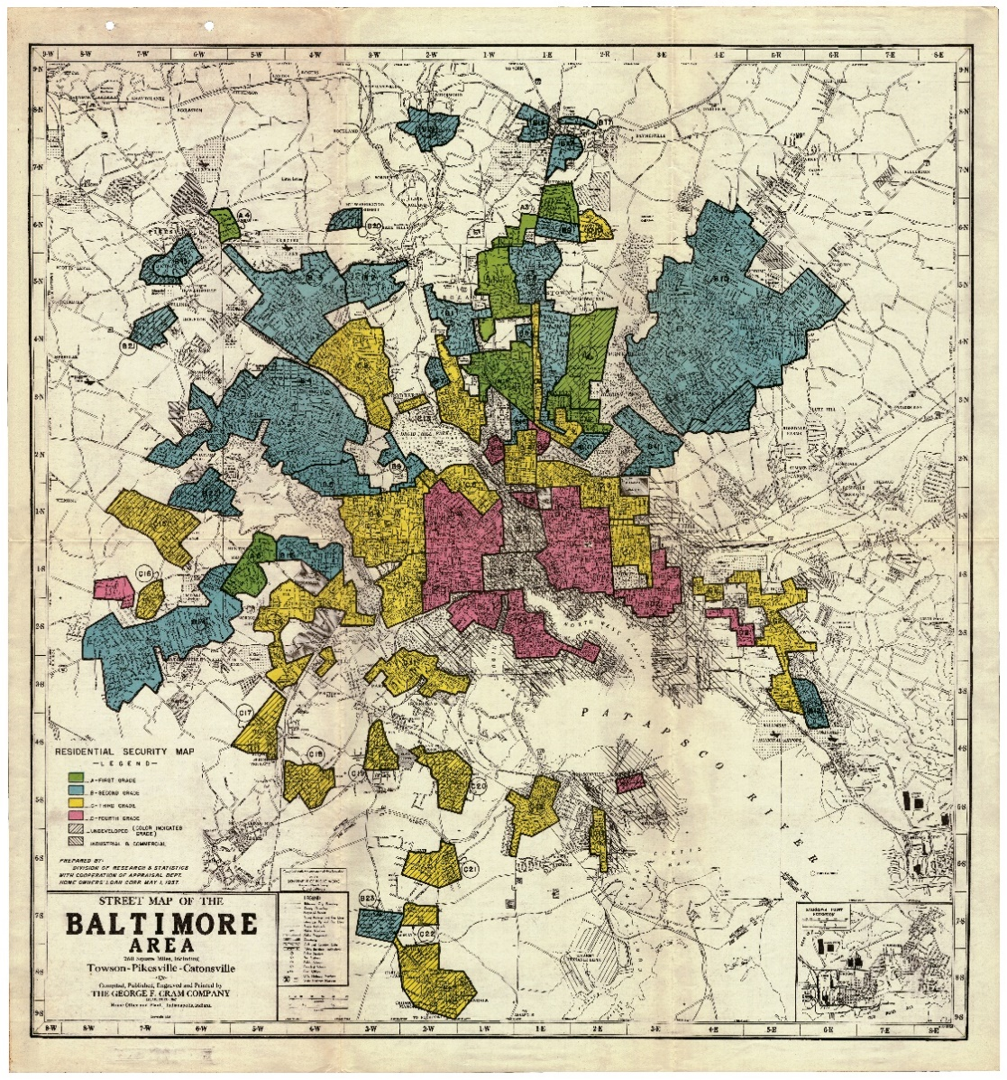
Racism Can Influence Where You Live.
And Where You Live Matters.
Baltimore City Redlining Map, 1937

Slide 9
Why Focus on Infant Mortality?
  IMR is known to be one of the most sensitive indicators of population health for a community
  IMR is used more generally as a crude indicator of:
  Population-level Health
  Distribution of Social Determinants of Health
  Access & Quality of Health Services

Slide 10
Data Source: Linked
Birth & Death Records
Data from 2013-2016 birth certificates were linked with data from 2013-2017 death certificates for this analysis, Baltimore City Residents only

Slide 11
Definitions
Infant Mortality: Death occurring between birth to under 1 year of age
Neonatal death: Death occurring between birth and under 28 days of age
Post-Neonatal death: Death occurring between 28 days and under 1 year of age
Sleep-Related Infant death: Infant death due to Sudden Infant Death Syndrome (SIDS), Accidental Asphyxiation or suffocation in bed (ASSB), or Unknown cause associated with infant sleep

Slide 12
Background

Slide 13
Baltimore City
In 2017, a total of 69 infants died, resulting in an infant mortality rate of 8.7 infant deaths per 1,000 live births
In 2017, a Black infant was about 4.2 times more likely to die than a White infant, resulting in 26 excess Black infant deaths*
In 2017, Baltimore City’s infant mortality rate was 1.3 times greater than Maryland’s rate, resulting in 17 excess infant deaths*
* Excess infant deaths are those that would have been prevented if the infant mortality rates were equal for both groups being compared
Notes:
Alternative Title: Baltimore City in 2016

Slide 14
Infant Mortality Rates:
USA, Maryland, Baltimore City (2017)
& Healthy People 2020 Goal
Notes:
Here I have a couple things I want to point out:
Baltimore City has higher rates across all categories; and has a particularly high rate of post-neonatal deaths than MD or USA
Across all categories, USA is meeting or is nearly meeting the 2020 Goal set by the CDC

Slide 15
Infant Mortality Rates Over Time
Baltimore City & Maryland
2007-2017

Slide 16
Baltimore City: 2009 v. 2017

Slide 17
Leading Causes of Infant Mortality:
United States vs. Baltimore City

Slide 18
Leading Causes of Infant Mortality,
Baltimore City, 2013-2017
Shift in top cause of death
For Older Infants

Slide 19
Baltimore City Sleep-Related Infant Deaths
2008-2018
BHB Inception, 2009
Notes:
Alternative Title: Decline in Sleep-Related Deaths since BHB Inception

Slide 20
Infant Characteristics:

Slide 21
Race/Ethnicity by Outcome
2013-2017
Notes:
Black infants are disproportionately represented among infant deaths and sleep deaths
Native population is disproportionality represented among sleep-related deaths at 4.3%, mirroring the data at the national level.
Alternative Title: Black infants disproportionately make up the majority of infant and sleep-related deaths

Slide 22
Infant Mortality by Sex
2013-2017

Slide 23
Percent of Live Births and Infant Deaths by Gestational Age:
NH Black Infants
2013-2017

Slide 24
Percent of Live Births and Infant Deaths by Gestational Age:
Hispanic/Latinx Infants
2013-2017

Slide 25
Percent of Live Births and Infant Deaths by Gestational Age:
NH White Infants
2013-2017

Slide 26
Gestational Age and Infant Mortality by Race/Ethnicity
2013-2017

Slide 27
Percent of Live Births and Infant Deaths by Birth Weight:
NH Black Infants
2013-2017

Slide 28
Percent of Live Births and Infant Deaths by Birth Weight:
Hispanic/Latinx Infants
2013-2017

Slide 29
Percent of Live Births and Infant Deaths by Birth Weight:
NH White Infants
2013-2017

Slide 30
Birth Weight and Infant Mortality by Race/Ethnicity
2013-2017
N=18
N=159
N=9
N=2
N=9

Slide 31
Maternal
Characteristics:
Notes:
In these next slides, you will see data looking at indicators impacting infant mortality.
I will be looking at disparities, and will be focusing on the Black, White and Hispanic populations
You will notice that the Hispanic population is only sometimes displayed and that is because the number of births and deaths in this population is often low, which destabilizes the statistic.

Slide 32
Infant Mortality Rate by
Maternal Age Categories
2013-2017

Slide 33
Infant Mortality Rate by
Maternal Education
2013-2017

Slide 34
Infant Mortality Rate by
Marital Status
2013-2017
N=5
Notes:
Alternative Title: Being married shows to be a protective factor for NH Whites only; little to no difference for NH Black and Hispanic/Latina

Slide 35
Infant Mortality Rate by
Insurance Type
2013-2017
N=173
N=5
N=22
N=53
N=1

Slide 36
Pregnancy
Characteristics:

Slide 37
Infant Mortality Rate by
Birth Spacing: Birth to Conception
2013-2017

Slide 38
Infant Mortality Rate by Birth Spacing:
Birth to Conception (≤18mths Inadequate)
2013-2017

Slide 39
Infant Mortality Rate by
Prenatal Care Access
2013-2017
N=32
N=168
N=9
N=4
N=29
N=5

Slide 40
Infant Mortality Rate by
Prenatal Care Entry
2013-2017

Slide 41
Infant Mortality Rate by
Teen Birth
2013-2017
N=44
N=222
N=16
N=2
N=24
N=2

Slide 42
Infant Mortality Rate by
Teen Birth, Multiple Births
2013-2017
N=44
N=222
N=2
N=21
N=3

Slide 43
Infant Mortality Rate by
Body Mass Index
2013-2017
Notes:
IMR stays relatively the same for Black and Hispanic populations across all BMI categories, suggesting healthy BMI is not a protective factor in these populations
White IMR follows a dose-response trend, with IMR steadily increasing as we move from healthy to obese
Alternative Title: Healthy BMI is a protective factor for NH Whites only

Slide 44
Infant Mortality Rate by
Chronic Hypertension
2013-2017
N=16
N=2

Slide 45
Infant Mortality Rate by
Reported Smoking During Pregnancy
2013-2017

Slide 46
Summary Notes

Slide 47
Summary By Race: Gestational Age
Percent of extreme preterm birth is nearly double in NH Black infants compared to NH White infants
Extreme preterm birth accounts for 60% of Infant Deaths in NH Black Infants and 53% of Infant Deaths in Latinx Infants (compared to 37% in NH White Infants)
Latinx infants have highest mortality rates in extremely preterm and mid to late term births

Slide 48
Summary By Race: Birth Weight
Percent of extreme low BW birth is over 3x higher in NH Black infants compared to NH White infants
Extreme low birthweight birth accounts for 61% of Infant Deaths in NH Black Infants and 53% in Latinx Infants (compared to 40% in NH White Infants)

Slide 49
Summary By Race:
Maternal Characteristics
NH Black mothers experience highest IMR at 35-39yrs compared to NH White mothers who experience highest IMR at 15-17yrs
NH Black IMR reduced by one-third with more than high school education, but still more than twice as high as other racial/ethnic groups in that same category
NH Black IMR highest among both Medicaid and Private insurance, while NH White IMR is decreased by nearly half under Private Insurance

Slide 50
Summary By Race:
Pregnancy Characteristics
All groups have elevated IMR in No PNC category
IMR similar for NH Black teens and adults, IMR a lot more elevated for NH White teens than adults (although N is small)
IMR remains fairly stable across BMI cats for NH Black and Latinx, while NH White IMR decreases with lower BMI
IMR elevated for both Latinx and NH Black with chronic hypertension
IMR higher among NH Black non-smokers than NH White smokers

Slide 51
Summary By Race: Overall
NH Black IMR still elevated when looking within all protective factors (i.e. insurance, education, BMI, smoking) when compared to NH White
NH White had highest IMR among very small birth spacing and first teen birth, although the N is small in both cases
Latinx had the highest IMR among the No PNC category, although the N is small

